Slide 1

Actuation of Pico-Liter Drops by Stick-Slip Motion
Arizona Space Grant 2010 Statewide Symposium
Devon Powell
Dr. Peter Bennett, Mentor
ASU Physics Department

Slide 2
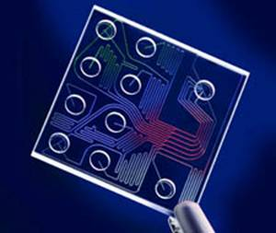
Background
Microfluidic devices for processing discrete volumes require manipulation of liquid drops on a surface.
Applications:
  Molecular biology
  DNA analysis
  Proteomics
  Clinical pathology
Some existing methods:
  Electrowetting
  Dielectrophoresis
  Ratcheting on asymmetric
  surfaces
http://cores.montana.edu/uploads/images/misc/Fxnl%20Genomics
%20Core%20Facility/microfluidics.jpg
Notes:
-Useful for routing, reaction, assaying, etc. of tiny, controlled volumes.
-Electrowetting = apply electric field to change wetting properties in strategic locations around droplet
-Dielectrophoresis = nonuniform electric field generates net force in dielectric
-Only one paper (Daniel et al.) exists on stick-slip specifically

Slide 3
Objective
Translate nano- to pico-liter droplets
  Stick-slip
  Asymmetric (i.e., sawtooth) vibration
Operating Principles:
  Difference between static and kinetic “friction”
  Contact angle hysteresis
  Droplet resonance
Flexibility due to real-time control
Slow, droplet sticks
Fast, droplet slips
Net displacement
Notes:
-CAH characterizes friction, more detail later
-Reversal of motion passing through resonance

Slide 4
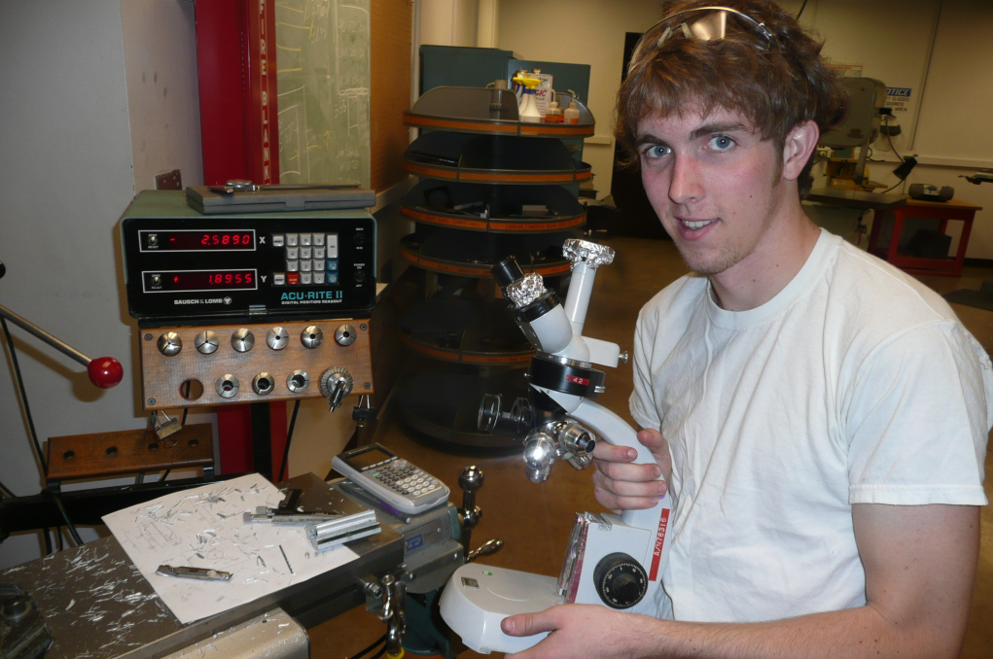
Achievements To Date
Apparatus Construction
Surface Treatments
Initial contact angle measurements
  Contact angle hysteresis
Verified resonant behavior in large water droplets
  Daniel et al.
Me Working - Picture Here

Slide 5
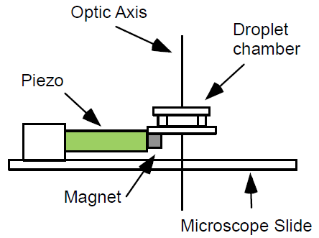
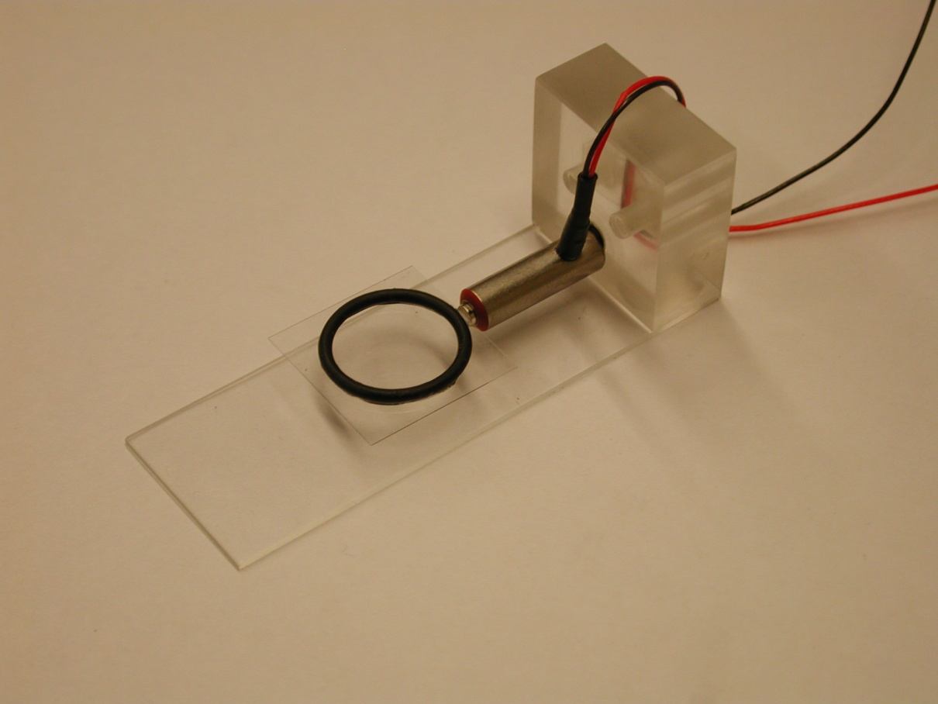
Apparatus
Viewing chamber
  Magnetic mount, mechanical in future
Piezo system
Camera, LCD strobe
New scope modification
  CCD camera
  Long distance objective
Lab Photo
Notes:
-CCD camera = more versatile for video analysis

Slide 6
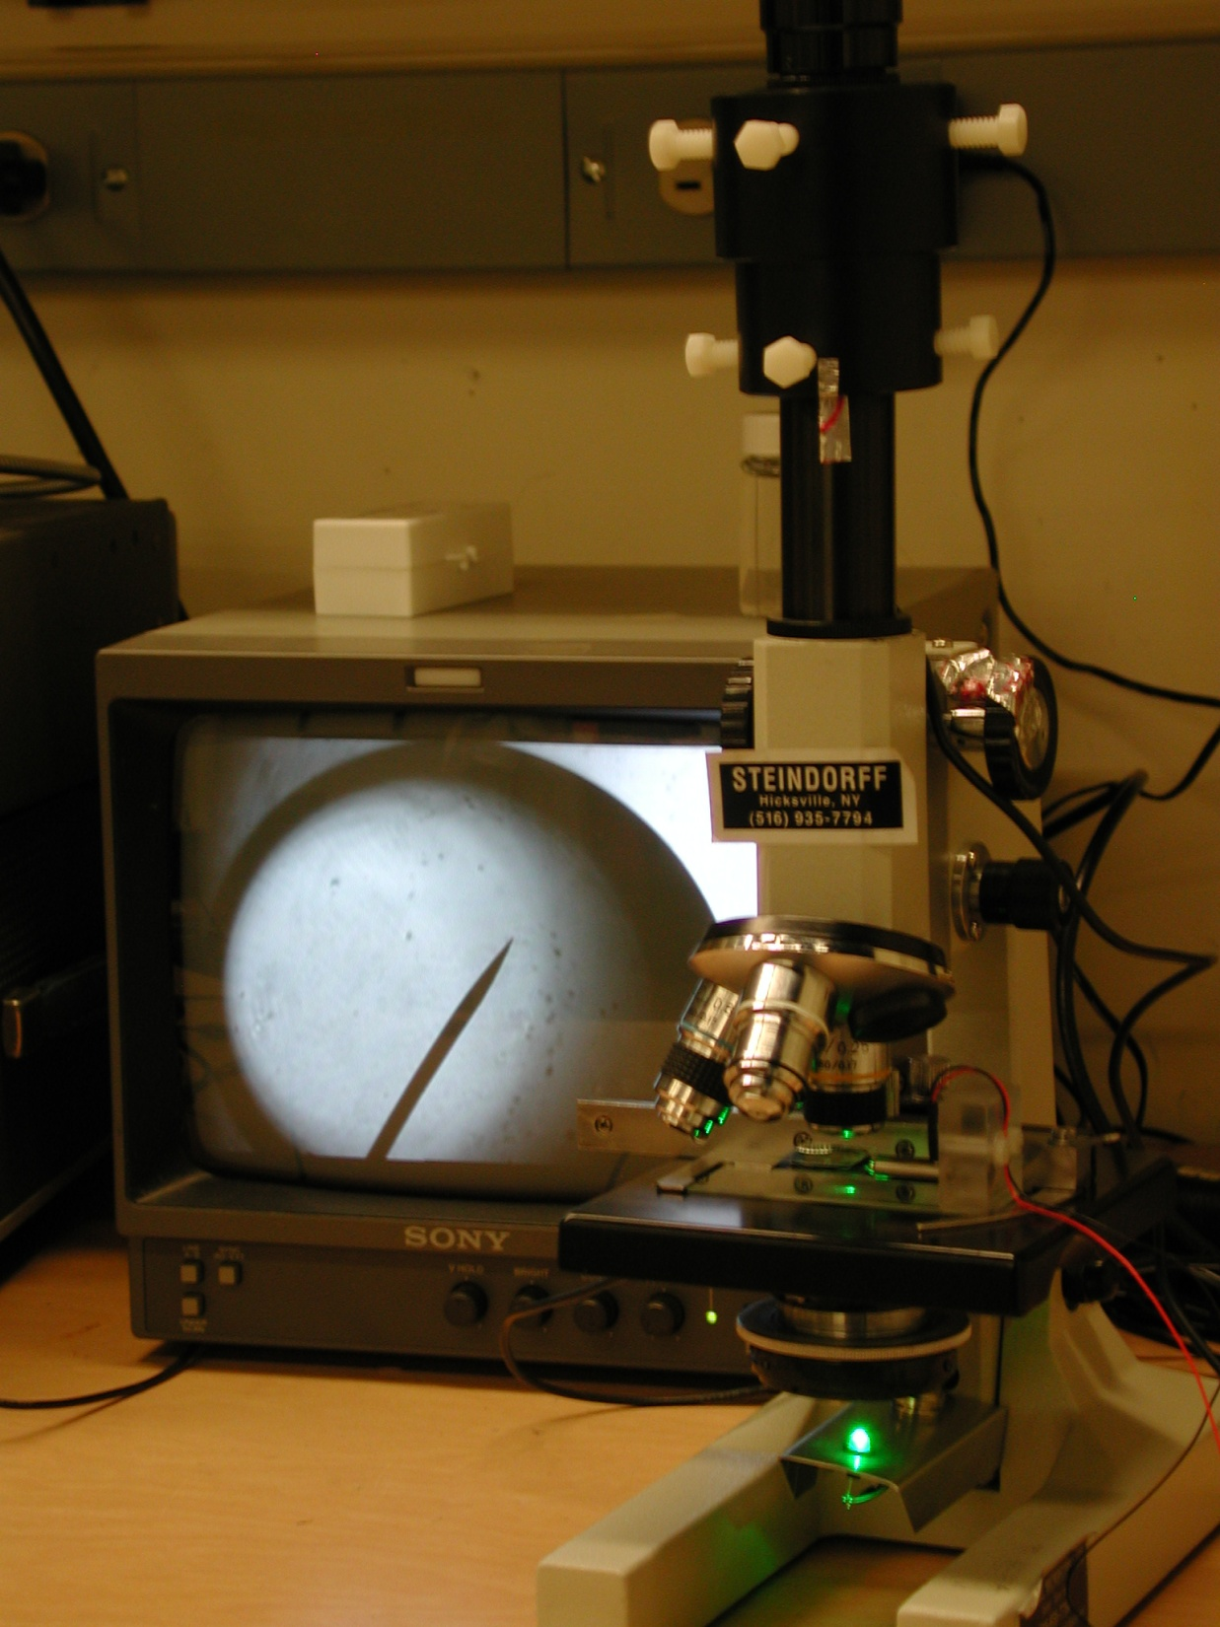
Lab Photo

Slide 7
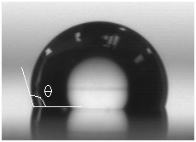
Surfaces/Sessile Contact Angle
HF-dipped silicon
  Good hydrophobicity
  Poor persistence
Treated glass
  OTS
  ~106°
Future:
  Silanized silicon
  Mercury on glass
Lab Photo
Notes:
-Octadecyltrichlorosilane
-Mercury = good future test medium. ~0 vapor pressure, little surface prep needed.

Slide 8

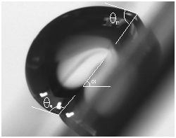
Contact Angle Hysteresis
Poor CAH data
  α = 37-62°
  Assume uniform contact line
  Need better surface condition
Dynamic measurement
  Substrate tracking
Lab Photo
Notes:
-David Quere, Non-Sticking Drops
-Assume circular contact line, same for all drops
-Find frequency where drop slips, calculate threshold shear acceleration.

Slide 9
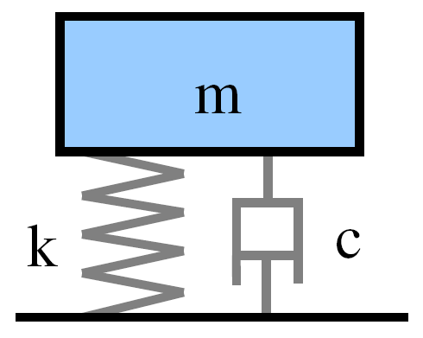


Resonance
Mass-spring analogy
  Inertia m
  Restorative force kx
For droplets,

Slide 10
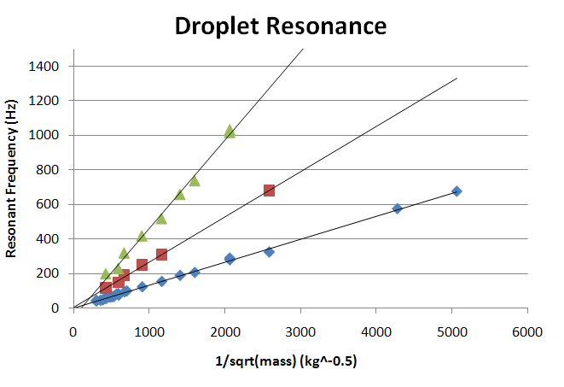

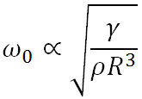
Resonance
Notes:
-Vibration-Actuated Drop Motion, headed by Susan Daniel, Lehigh university
-Verified in Hg as well
-Rocking mode dependent on effective contact angle

Slide 11
Thank You

